Slide 1
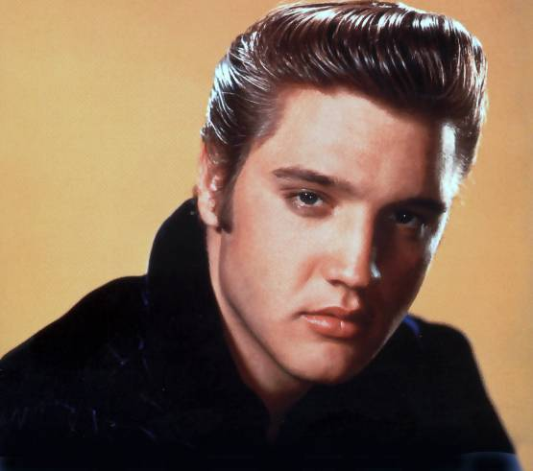
Philosophy: The ELVIS Model
Doing it my way…
by
Gary J. Conti

Slide 2
What is philosophy…
Set of assumptions
Fundamental questions about:
View of Knowledge
Nature of the Learner
Nature of the Curriculum
Role of the Teacher
No right or wrong approach
Different role for the teacher

Slide 3
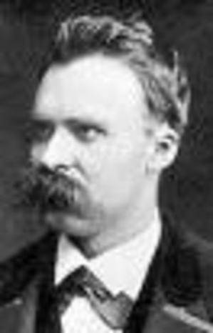
Traditional View…

Slide 4
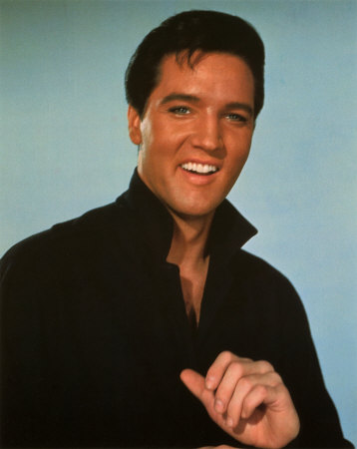
Elvis Advises…
What alternative approach would Elvis suggest to shake things up?
What happens when we shake things up?
What happens when we encounter special things?

Slide 5
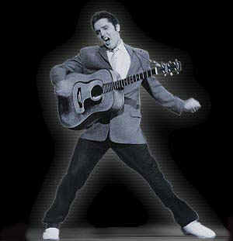
Alternative Approach:
What alternative approach would Elvis suggest to shake things up?

Slide 6
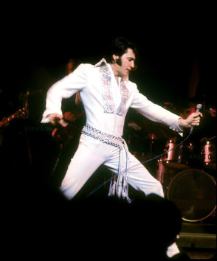
Alternative Approach: Shaking things up…
PHIL
Philosophies Held by Instructors of Lifelong-learners
Placement in philosophical school
Quick
Identify your educational beliefs

Slide 7
ELVIS Model…
Uses ELVIS memories
Enliven the philosophies
Help us remember the parts
What does Elvis have to tell us?

Slide 8
Historical Development…
Time Period | Philosophy
Greeks to Middle Ages | Idealism
Scientific Revolution | Realism
Industrial Revolution | Progressivism
Post World War II | Humanism
Challenge Status Quo | Reconstructionism

Slide 9
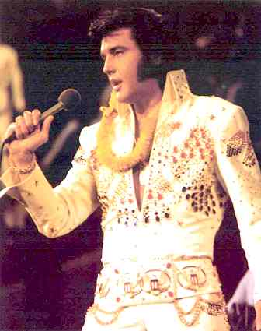
ELVIS Model...
E: Emotional
L: Linkage of Individual and Society
V: Vision
I : Inquisitiveness
S : Scientific

Slide 10
Elvis Advises…
What does Elvis have to tell us about the importance of:
Emotions
Perceptions

Slide 11
Emotional: Humanism
What is Elvis telling us about emotions?

Slide 12
Emotional: Humanism Individuals are always in transition
Focus on the individual
Constant need for choice
Aims
Self-understanding
Promote involvement in life
Develop commitment to choices
Instructional process:
Allow student options
Role of teacher
To explore possibilities
Facilitator

Slide 13
Elvis Advises…
What skills exist among the members of the group?
What is Elvis telling us about the members of this group?

Slide 14
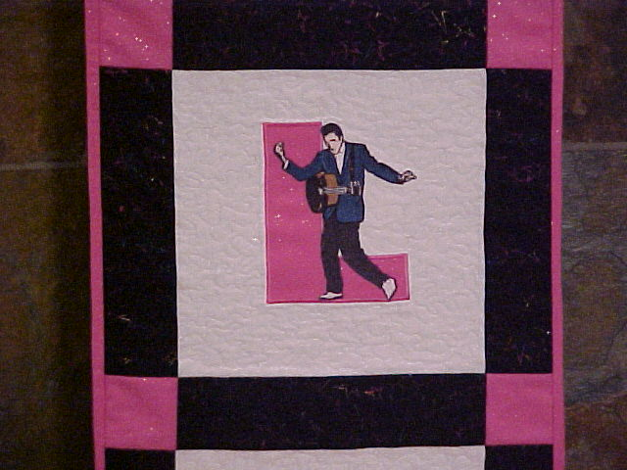
Linkage: Pragmatism
What skill or talent does each person have?

Slide 15
Linkage: Pragmatism Inquire then do what works best
Teach both liberal arts and vocational education
Centrality of human experience
Aims
Teach a process of inquiry
Promote democracy
Foster:
Personal Development
Betterment of Society
Instructional process
Individual differences
Problem solving and discovery
Role of teacher
Identify needs
Resource person

Slide 16
Elvis Advises…
What is Elvis telling us about social responsibility?
Who is involved?
What happens when we don’t care for others?

Slide 17
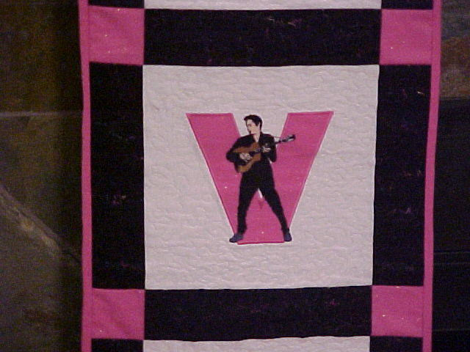
Vision: Reconstructionism
What is Elvis telling us about social responsibility?

Slide 18
Vision: Reconstructionism Education can be used in reconstructing society
Change rather than adjust
Holistic view of problems
Futuristic
Aims
Social activism
Encourage change agents
Instructional process
Develop decision-making abilities
Involve in social issues
Role of teacher (group leader)
Question role of teacher
Engage learners in action projects

Slide 19
Elvis Advises…
What is Elvis teaching us about reflection and critical thinking?

Slide 20
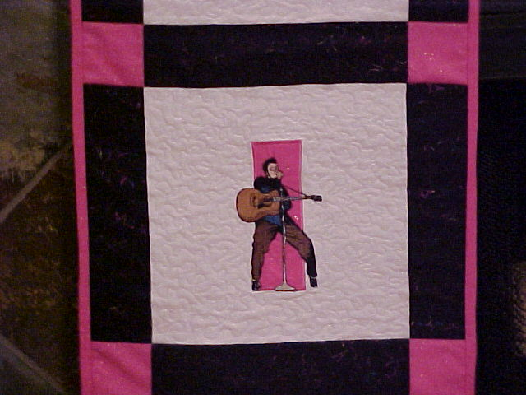
Inquisitiveness: Idealism
What is the structure of this song?

Slide 21
Inquisitiveness: Idealism Ideas are the only true reality
Ideas are enduring
Discovering vs creating knowledge
Aims
Search for truth
Character development
Develop critical thinkers
Role of teacher:
Guide immature learners
Instructional process:
Broad concepts vs specific skills
Socratic Method: Questioning

Slide 22
Elvis Advises…
What constitutes reality according to Elvis?

Slide 23
Scientific: Realism
What is real in this song?
What is not real?

Slide 24
Scientific: Realism Reality exists independent of the human mind
Discover ideas by studying world
Aims
Understand world through inquiry
Verify ideas in world of experience
Instructional process
Teach fundamentals
Encourage specialization
Teach scientific method
Role of teacher
Present material systematically
Encourage use of objective criteria
Be effective and accountable

Slide 25
Basic Adult Learning Principles…
Characteristic | Description
Learner’s Self- Concept | Adults have a self-concept of being responsible for their own decisions and own lives. They are self-directed in their learning and may not respond well to competition.
Experiences | Adults enter a learning activity with a vast reservoir of experiences that can serve as a rich foundation for learning.
Readiness to Learn | Adults come ready to learn those things they need to know and need to do in order to cope effectively with real-life situations. They learn according to their social roles.

Slide 26
Orientation to Learning | Adults are problem-centered in response to pressures they feel in their current life situation and have a perspective of immediacy of application toward most of their learning.
Need to Know | Adults need to know why they need to learn something before undertaking to learn it.
Motivation | While adults are responsive to some external motivators such as better jobs or higher salaries, the most potent motivators are internal pressures such as the desire to increase job satisfaction or self-esteem.
Active Involvement | Participation! Participation!! Participation!!! The fundamental principle of adult education.

Slide 27
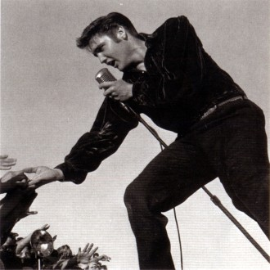
Summary Learning Principles...
Learner-Centered
Address Individual Differences
Through Experiences
Reflect on experiences
Give meaning to experiences
Built on:
Mutual respect
Self-direction
Responsibility
Trust

Slide 28
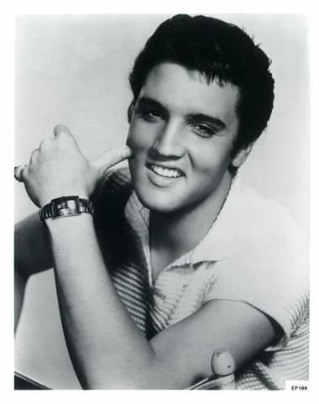
Why Emphasize Philosophy?
Understand yourself (metacognition)
Increased professionalism
Understand colleagues
Relate to colleagues
Present consistent face to others
Supports teaching style research
Promotes learner self-direction

Slide 29
Bottom Line…
In education because of:
Dreams
Goals
Passion
When married with adult learning principles:
More effective
More professional
Activated with the ELVIS Model…

Slide 30
Excellent Books...
Elias, J. L., & Merriam, S. (2005). Philosophical foundations of adult education (3rd Ed.). Malabar, FL: Krieger Publishing Co.
Ozmon, H. A., & Craver, S. M. (1981). Philosophical foundations of education (2nd Ed.). Columbus, OH: Merrill Publishing Co.

Slide 31
Award-Winning Quilt…
By Linda D. Conti

