Slide 1
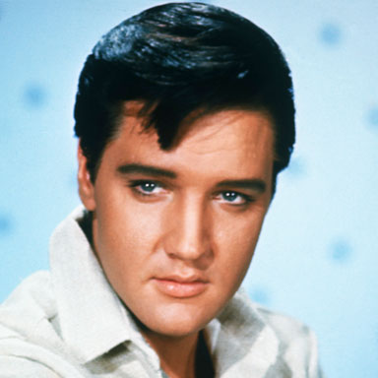
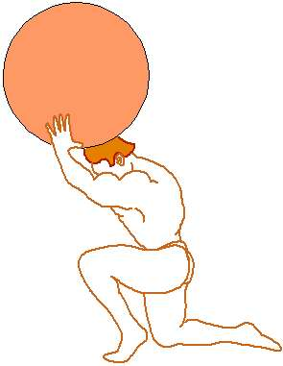
Taking Care of Business:
Addressing
Individual
Differences…
Gary J. Conti

Slide 2

State of Education…
Many questions and issues
Central question:
  What can we do to improve learning?

Slide 3


Will Rogers…
If advertisers spent the same amount of money on improving their products as they do on advertising,
Then they wouldn't have to advertise them.

Slide 4

Learning is Natural…
Learning is what makes humans superior
Occurs naturally
  For children
  In adulthood
Why do “schools” have trouble?
Why do we have trouble “facilitating” learning?

Slide 5

Thinking Differently…
Take the blinders off
Learning Principles
  Not just for “teachers”
  All partners in same enterprise
  Just different roles

Slide 6
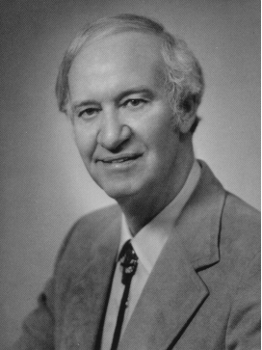
Adult Learning Theory…
Twin pillars
  Andragogy
  Self-Directed Learning
Learner-Centered
  Meaning of experiences
  Reflection
Focus on Individual Differences

Slide 7
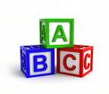
Basic Principles
Readiness to learn
  Related to social roles
Orientation to learn
  Time perspective
  Problem centered
Motivation is internal
Need to know why learning
Self-directed
  Learning climate
  Diagnosis of needs
  Involvement in planning
Experience
  Prior experiences
  Practical application

Slide 8


Our Special Guest…
To help us understand individual differences
To provide insights for us…

Slide 9
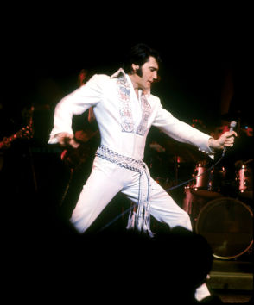
Let’s Shake Things Up…
What happens when you find something you love?

Slide 10
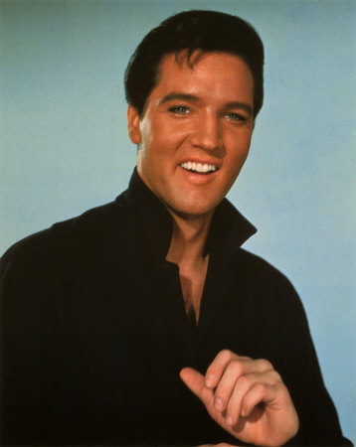
Elvis Advises…
What are Elvis’ thoughts on why we should pay attention to individual differences?
  What happens if we don’t focus on the individual?
  Might people look at things differently?

Slide 11
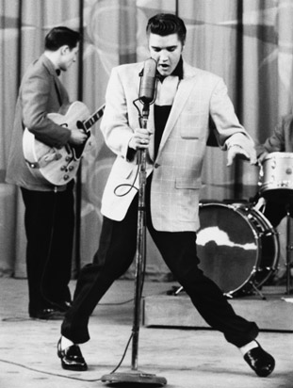
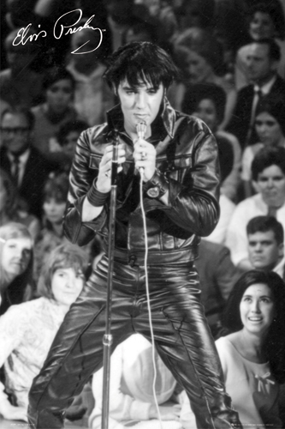
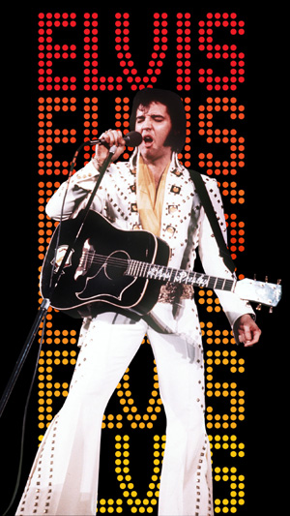
Individual Differences…
Why does Elvis think we should pay attention to individual differences?

Slide 12

ATLAS
Assessing The Learning Strategies of AdultS
Places person in category
User friendly
Flow-chart design
Let’s take ATLAS…

Slide 13
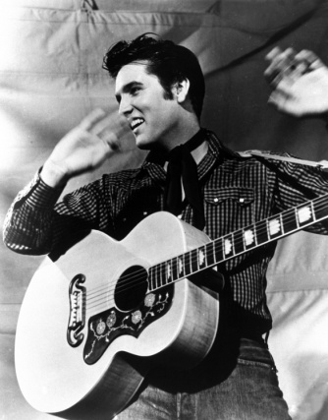
ATLAS has…
3 groups
  Navigators
  Problem Solvers
  Engagers
Let’s look in detail at each group…

Slide 14
Elvis Advises…
What is Elvis’ plan for the problem that he has?
  Does he have a clear plan?
  What does Elvis do if his plan does not work?

Slide 15

Planning…
What is Elvis’ plan for the problem that he has?

Slide 16


Navigators
Efficiency and Effectiveness
Demand for Order and Structure
  Like structure and are highly organized
  Want schedules and deadlines
  Use many organizational tools
  Want learning objectives and expectations
  Want control of their learning plan
  Set up plan and stick with it; will clarify things three times
Logic-Oriented
  Results oriented
  Emotions not important for learning
  Separate the learning message from the messenger
  Do not waste their time
Objective
  Do not like group discussions or group work
  Hate slackers
  Prefer clear final results
  Prefer formal evaluation
Perfectionist
  Seek perfection
  Trial-and-error means made a mistake
  Lack conditional acceptance
  Demand much of themselves
  Hyper-critical of errors
Motto
  Plan the work; work the plan

Slide 17
Elvis Advises…
What does Elvis have to tell us about having alternatives?
  Are dreams (alternatives) okay?
  What should you do with your dreams?

Slide 18
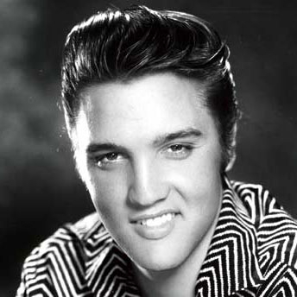
Generating Alternatives…
What does Elvis have to tell us about having alternatives?

Slide 19
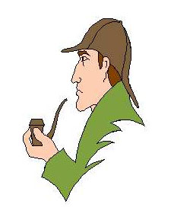
Problem Solvers
Generating Alternatives
Constantly Seeking Alternatives
  Open minded to learning possibilities
  Difficulty making decisions
  Procrastination because it allows thinking to continue
  Prefer open-ended evaluations
  Ongoing modification
  Trial-and-error means an experiment for generating more alternatives
Creative Solutions
  Curious; inventive; intuitive
  Love to explore ideas
  Do it their own way
  Do not respond well to rigidity
  Do not try to force them to do it your way
  Learning is an adventure for them
Deal with Ideas
  Like to think things through
  Confident in abilities
  Abstract thinkers
  Do not interrupt; hard time starting again
  Often think and deal in terms of symbols
Storytellers
  Descriptive and detailed in answers
  Use many examples
  Add delightful details to stories
  The process of telling the story is the important thing
  Competition of the story not important
Motto: Ask them what time it is, and they will build you a clock

Slide 20
Elvis Advises…
What does Elvis have to tell us about the importance of relationships?
  What are the best ones?
  Should they be acknowledged?

Slide 21

Relationships…
What does Elvis have to tell us about the importance of relationships?

Slide 22

Engagers
Building Relationships with Others
Feelings are the Key
  Learning must be Fun!
  Emotional; passionate; use feeling words
  Hard time separating themselves from their work
  Their work is a reflection of themselves
  Not engage if they will not enjoy it enough to be worth the effort
Aura of Excitement
  Enthusiastic; excitement
  Fully immerse themselves in the learning once they engage
  Seek and find joy in the learning process
  Delight in new accomplishments
  Get bored quickly; so seek to avoid boredom
Means and Not the End
  Learner must be actively engaged
  Learning has to have meaning
  Focus on meeting internal needs rather than external standards
  Want teachers to focus on the learning rather than on the evaluation
  Want involvement in learning based on their own individual interests
Relationships
  Love group work
  Want teachers have interest in them
  Develop an emotional affinity with the teacher
  Share accomplishments with others
  Use human resources
Motto: “It is FUN!!

Slide 23



Symbol for Each Group..
Navigators
Engagers
Problem Solvers

Slide 24
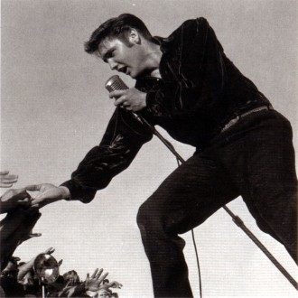
What’s the Value...
Learner
  Metacognition
  Depersonalizes learning
  Personal insights
Teacher
  Way to identify differences
  Use instrument
  Use characteristics
Preference for initiating learning
Okay to be wrong
  Focus on observations
  Compare to theory
  Re-adjust
Elvis’ final words on why to use ATLAS…

Slide 25
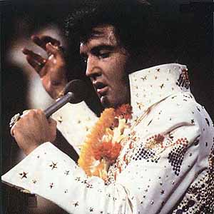
Why ATLAS Works…
Based on extensive research
Builds on two ideas
  Metacognition
  Instrumented Learning

Slide 26
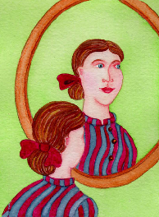
Metacognition…
Thinking about your thinking
Reflect on process you went through
  Think about what you did
  Self-consciously think about action
  Plan new action
Thinking about how you learn

Slide 27

Instrumented Learning
Instrument provides data
  Discover preferences
  Simplify complex issues
  Foster self-awareness
  Create common language
  Appreciate differences
Feedback for individual or team
Instrument completed by:
  Self
  Others for 360̊ feedback

Slide 28
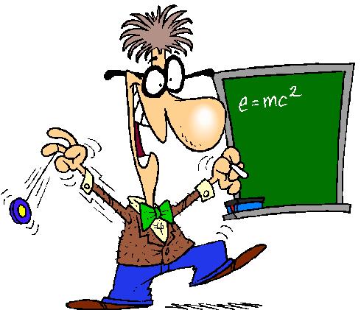
Results presented in context of a particular model such as:
  Behavior style
  Learning preference
  Personality type
  Situational factors
Popular with:
  Business
  Military

Slide 29

Learning Strategies…
Metacognition: Knowing about own learning process
  Planning
  Monitoring
  Adjusting
Metamotivation: Awareness of what energizes your learning
  Attention
  Reward/Enjoyment:
  Confidence
Memory: The storage and retrieval of knowledge
  Organization
  Use of External Aids
  Memory Application
Critical Thinking: Reflective thinking process
  Testing Assumptions
  Generating Alternatives
  Conditional Acceptance
Resource Management: Ways to use resources
  Identification of Resources
  Critical Use of Resources
  Use of Human Resources

Slide 30

ATLAS Research
Programmatic line of inquiry
42 dissertations
Ways used
  To better describe the groups in ATLAS
  To test the instrument with groups
  As auxiliary tool
  Experimental format
Findings
  Lack of demographic relationships
  Clear description of groups
  General distribution of groups
  Association with image of organization
  Helps learning

Slide 31
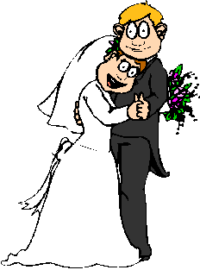
Relationship to Learning…
Munday (Wendy), Munday (Don)…
  Experimental studies
  Tested academic gain
  Both found significant academic gain
  Focus groups
Metacognition
  Know how to deal with their own characteristics
  Understand others
  Aware of more options

Slide 32
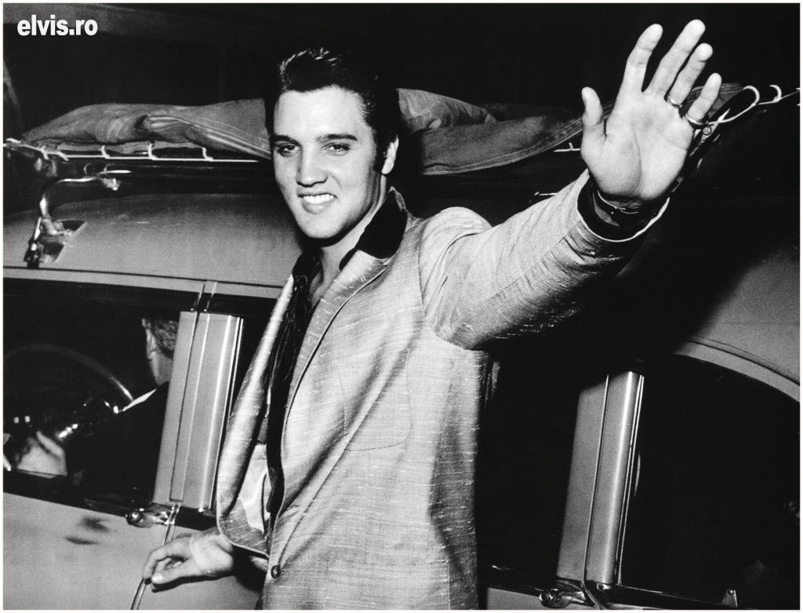

Slide 33
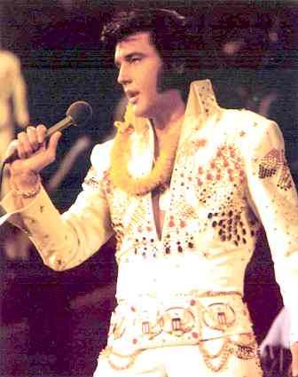
Implications for…
Marketing
Staff Development
Programming
Physical Layout
Support Services
Class Scheduling
Staffing
Scheduling
Budgeting
Institutional Research
Recognition Activities
Evaluation

Slide 34
Get ATLAS…
Online:
  w w w.conti-creations.com/start.htm
Paper format
  Original colored booklet
  1-page folding copy

